Slide 1
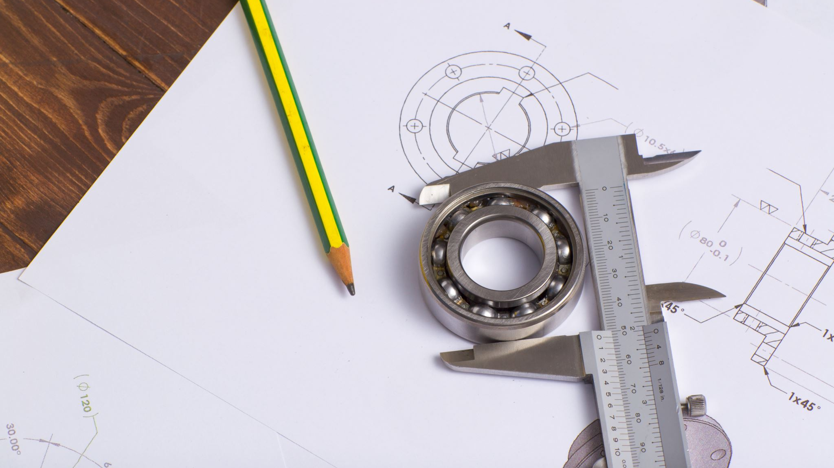
Mechanical Parts Classifyer with Convolutional Neural Network
Abi Rahman Sugiri
FTDS RMT 021

Slide 2
Introduction
Objectives
Problem Statement

Slide 3
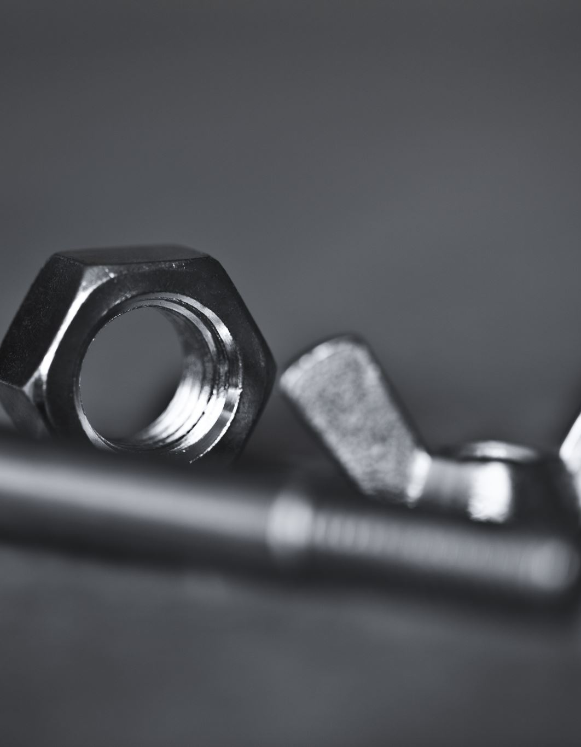
Data Set
3d generated images:
Bolt
Locating pin
Washer
Nut
Over 1500 images for each class

Slide 4
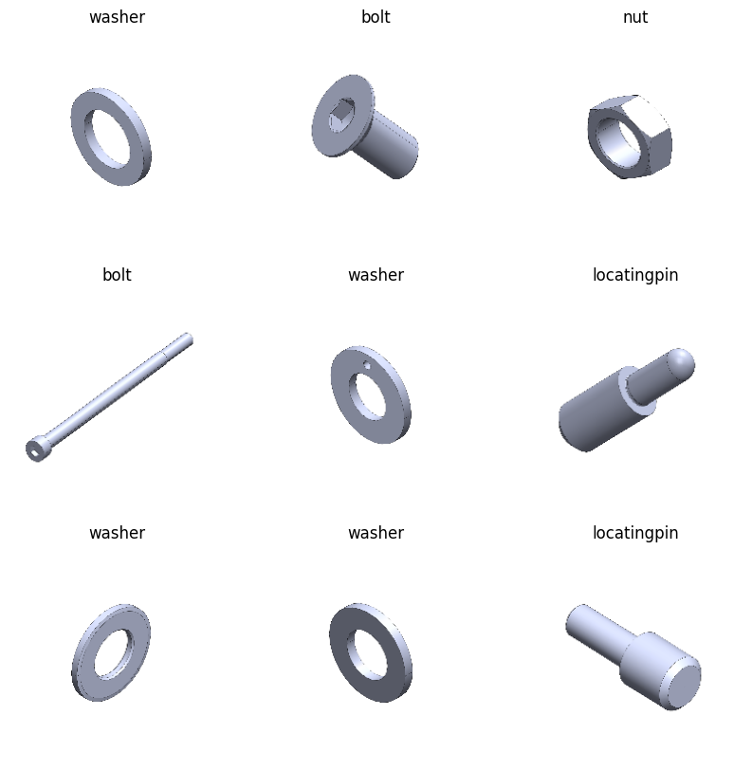
Examples

Slide 5
Steps
Splitting Data set
Exploratory Data Analysis (EDA)
Model Training
Model Evaluation
Model Improvement

Slide 6
EDA
Checking data files for each set
Plotting images (original and gray scale)
Image resizing

Slide 7
Data Preprocessing
Assign class number
Data Augmentation

Slide 8
Data Augmentation
Parameters
RandomFlip | Horizontal
RandomRotation | 0.3
RandomBrightness | 0.3
RandomZoom | 0.2

Slide 9

First Model

Slide 10
Model Training
First Model Parameters
Augmented Data
layers.Rescaling(1/255, input_shape= inputs)
layers.Conv2D(16, 3, activation='relu')
layers.MaxPooling2D(),
layers.Conv2D(32, 3, activation='relu')
layers.MaxPooling2D(padding='valid')
layers.Flatten(),
layers.Dense(128, activation= 'relu')
layers.Dense(64, activation= 'relu')
layers.Dense(4, activation= 'softmax')

Slide 11
Model Compiler
Adam Optimizer
Sparse Categorical Crossentropy
Metrics = Accuracy
100 Epoch

Slide 12
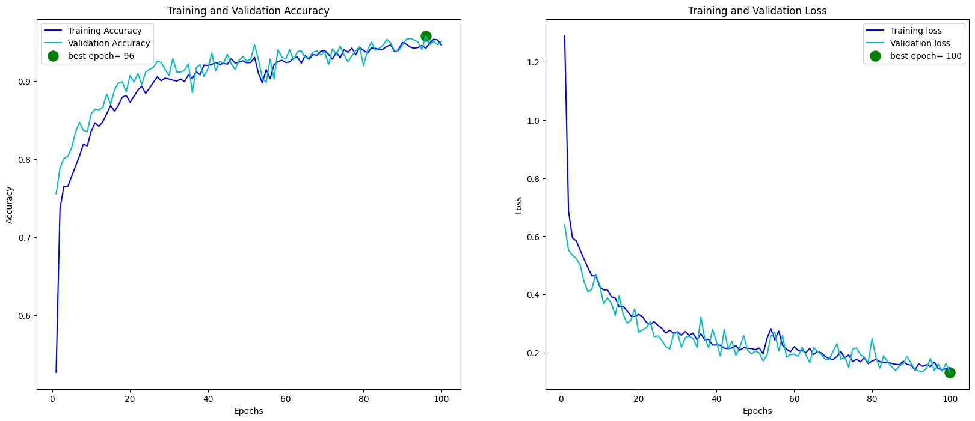
Model Evaluation

Slide 13
Model Evaluation
Test Loss | 0.13
Test Accuracy | 0.95

Slide 14
Second Model

Slide 15
Model Training
Second Model Parameters
Augmented Data
layers.Rescaling(1/255, input_shape= inputs)
layers.Conv2D(16, 3, activation='relu')
layers.MaxPooling2D()
layers.Conv2D(32, 3, activation='relu')
layers.MaxPooling2D(padding='valid')
layers.Flatten()
layers.Dense(64, activation= 'relu’)
layers.Dense(32, activation= 'relu’)
layers.Dropout(0.2)
layers.Dense(4, activation= 'softmax')

Slide 16
Model Compiler
Adam Optimizer
Sparse Categorical Crossentropy
Metrics = Accuracy
150 Epoch

Slide 17
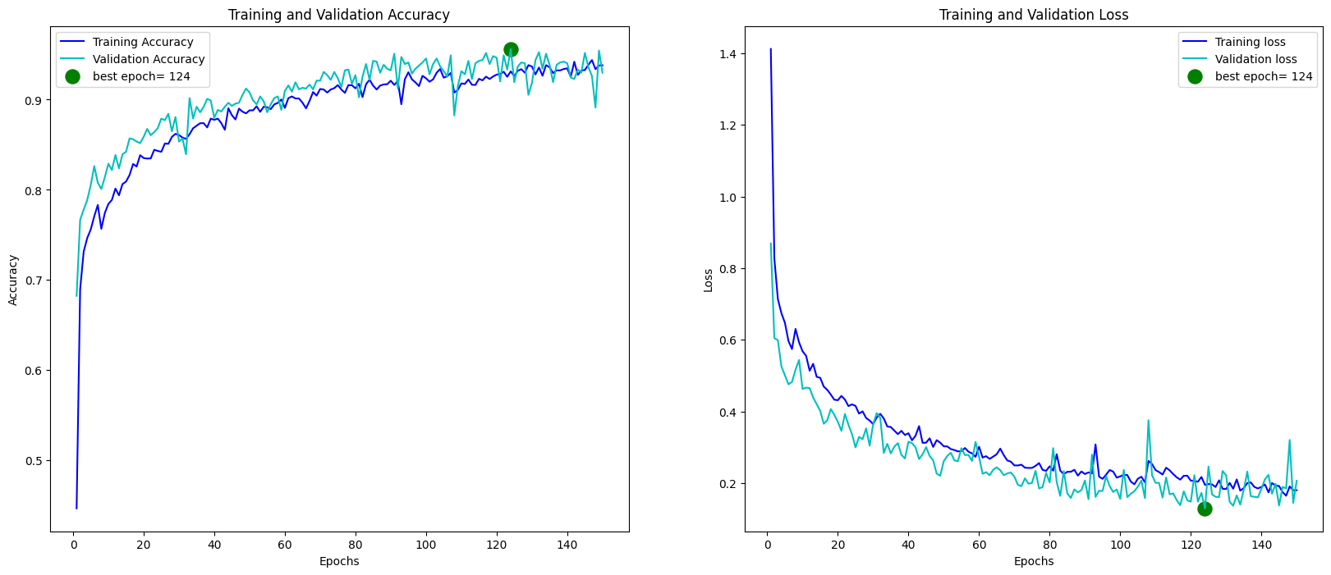
Model Evaluation

Slide 18
Model Evaluation
Test Loss | 0.23
Test Accuracy | 0.93

Slide 19
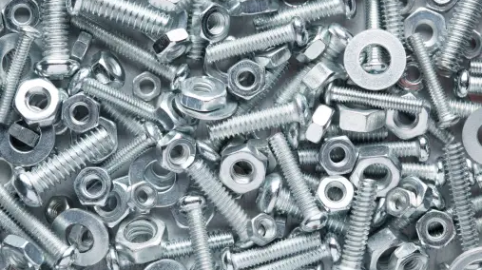
Thank You

